Slide 1
Semantic Search Engines

Slide 2
What’s it about?
From a web of documents to a web of objects
From keywords matching to concept matching (entities, relations, etc)
Computationally understand user intent
“Empower people with Knowledge” (OSD Mission)

Slide 3
How is it different?
Provide exact answers
“When was Barack Obama born?”
Result: August 4, 1961
Provide summaries
“financial crisis”
Result: a “wikipedia” like page for “financial crisis”

Slide 4
What’s under the hood?
NLP, Text mining
Ontology
Uncertain data management
RDF, OWL, graphs

Slide 5
Do users care?
Is semantic search engine trying to answer a question that does not exist?
Technology-push vs. demand-pull
A great battleground for big companies

Slide 6
The “semanticity” of semantic search engines
Well established measures
NDCG
Equivalent queries
Top 10 songs vs. Top ten songs
How many people live in Paris vs. What’s the population of Paris
Pablo Piccasso vs. Pablo Piccasso the Painter
Task oriented
How helpful it is for booking a trip?
Result-based vs. process-based

Slide 7





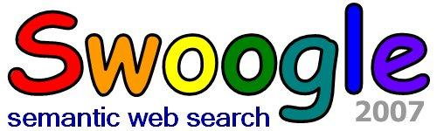








Slide 9
Facts
Who:
Barney Pell (founder, CTO)
Lorenzo Thione (previously with PARC)
Ronald Kaplan (previously with PARC)
Where:
San Francisco, CA
When:
May 2008.
August 1, 2008 acquired by Microsoft
Meaning: Mathematically, the powerset of a set S, usually written P(S), is the set of all possible subsets of S.

Slide 10
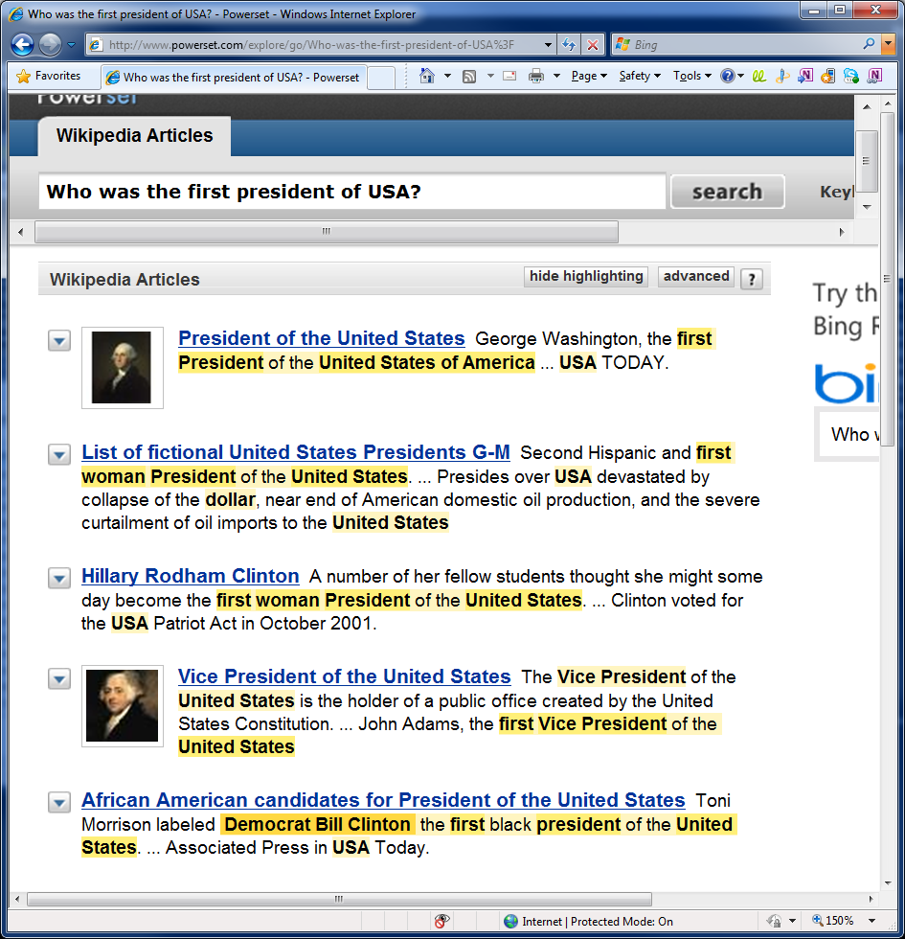
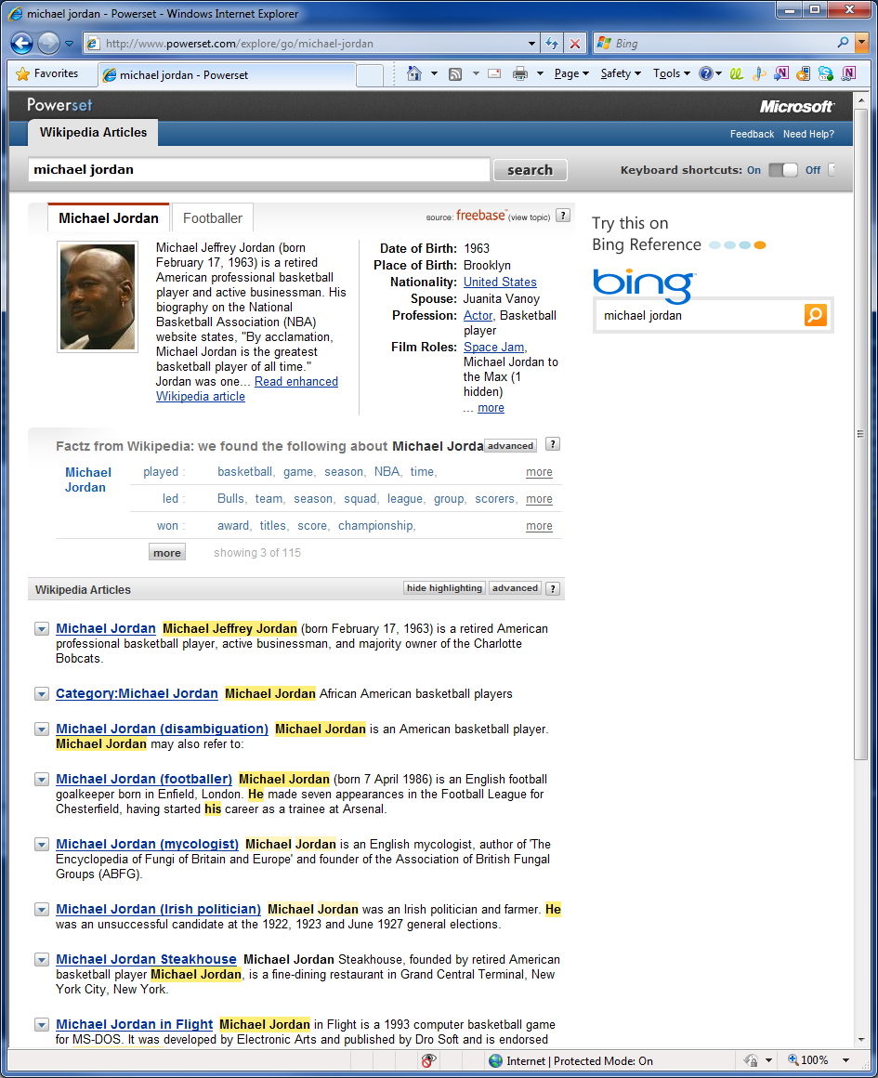
Sample Queries
Factz from Wikipedia™
Factz are information compiled from pages across Wikipedia.
They are expressed in 3 parts, two "things" connected by a "relationship."

Slide 11
Sample Queries
“Michael Jordan”
Freebase topic
Factz: MJ led bulls, MJ played NBA, MJ won championship, etc
Wiki articles (found other MJs)
“Michael Jordan’s height”
Only articles (simply index merging?)
Michael Jordan's Restaurant was …. adorned with a 25-foot (7.6-m) high cutout basketball
No correct answer in first page
Correct when search “Michael Jordan height”
“How tall is Michael Jordan”
Similar result as the above
“What’s Michael Jordan’s position”
Show “Shooting guard” directly from Freebase
Michael Jordan's first game back from playing minor league

Slide 12
Technology
Major Techniques
Xerox NLP parsing
NLP Queries, Factz (RDF triples)
Multiple index
Data Coverage
Freebase
Factz (from wiki)
Wiki articles

Slide 13
Strength and Weakness
Strengths
NLP parsing
Clean and direct answers if available
Weaknesses
Limited data coverage
Poor scalability

Slide 15
Facts
Who:
Riza Berkan (CEO, nuclear scientist by training)
Pentti Kouri (economist, venture capitalist)
Prof. Victor Raskin (father of ontological semantics)
Where:
Manhattan, New York
When:
2004
Hakia raised $21 million from private equity investors.

Slide 16
Major Techniques
QDEXing
SemanticRank
Commercial Ontology

Slide 17
QDEXing
QDEXing stands for “query detection and extraction”
Goal: diminish the extra “semantic” load on top of indexing
Google/Bing: a table of words versus document IDs
QDExing: a table of extracted queries (word sequences) versus paragraph IDs.
Key technique: Extracting query sequences from a typical Web page (500 words).

Slide 18
QDEXing Example
“In Norse mythology the polar aurora represents the Ride of the Valkyries to War.”
Queries:
aurora, mythology, Norse Mythology,
What is aurora?
In what mythology is aurora represented?
What does aurora represent in mythology?

Slide 19
QDEX
Pros
Small index (web pages increase rapidly but knowledge not)
Small active set
Fewer redundant results
No 2nd search problem
Cons
Cannot support keyword search?

Slide 20
Commercial Ontology
“CO can be viewed as a building with number of floors.”
“The very first floor contains a map of objects (nouns) including tangible things as well as conceptual nouns.”
“The second floor contains a map of events (verbs or actions).”
“Additional floors include time, place, and other dimensional information that are connected to the floors below.”

Slide 21
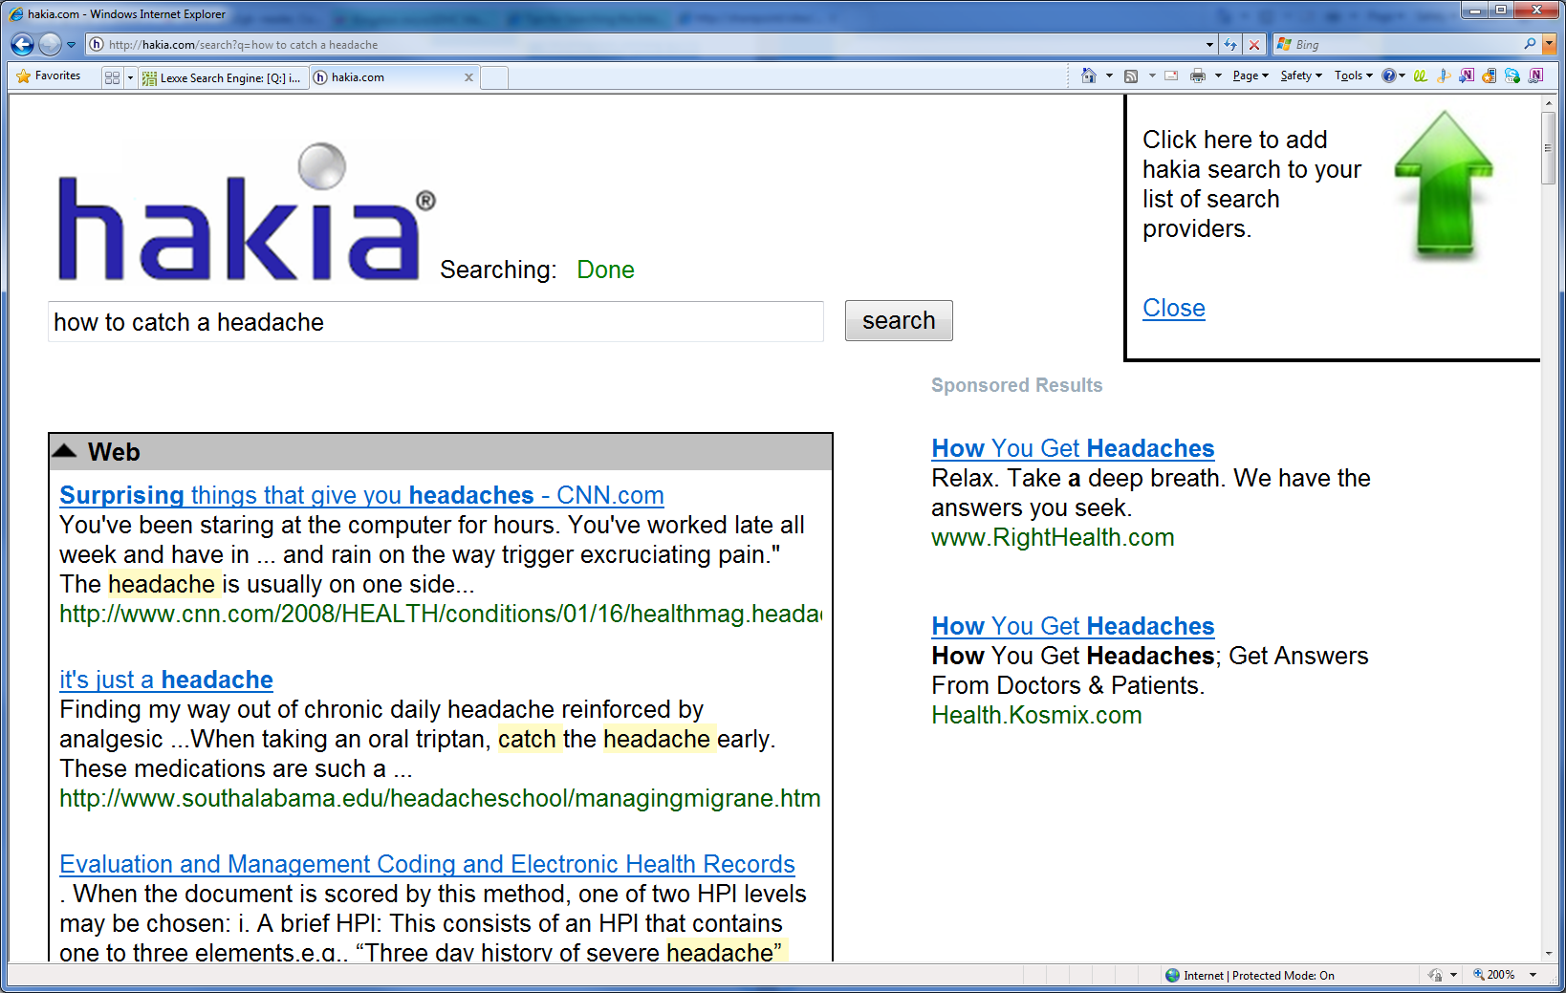
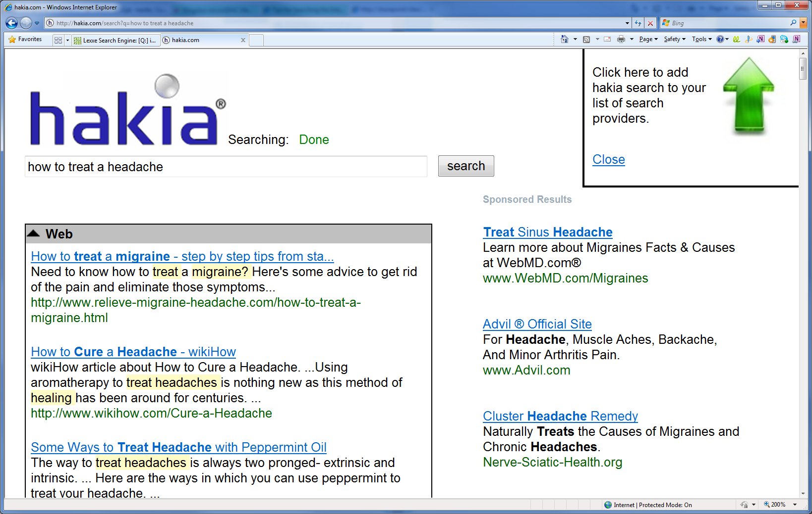

Slide 22
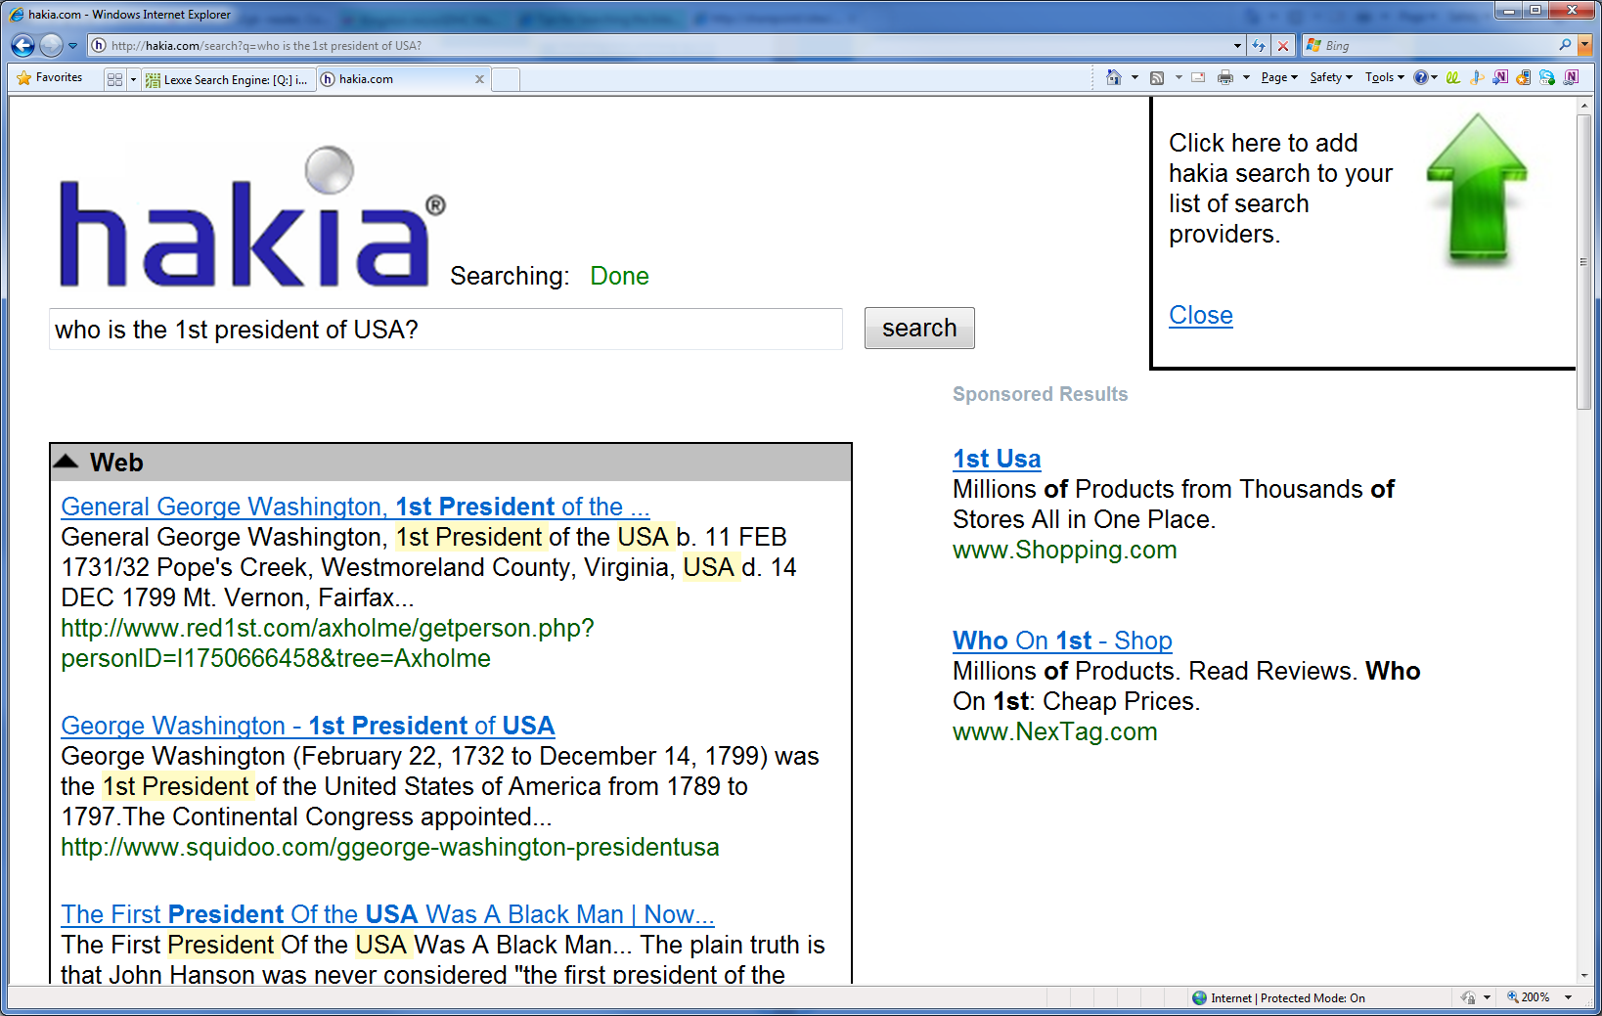
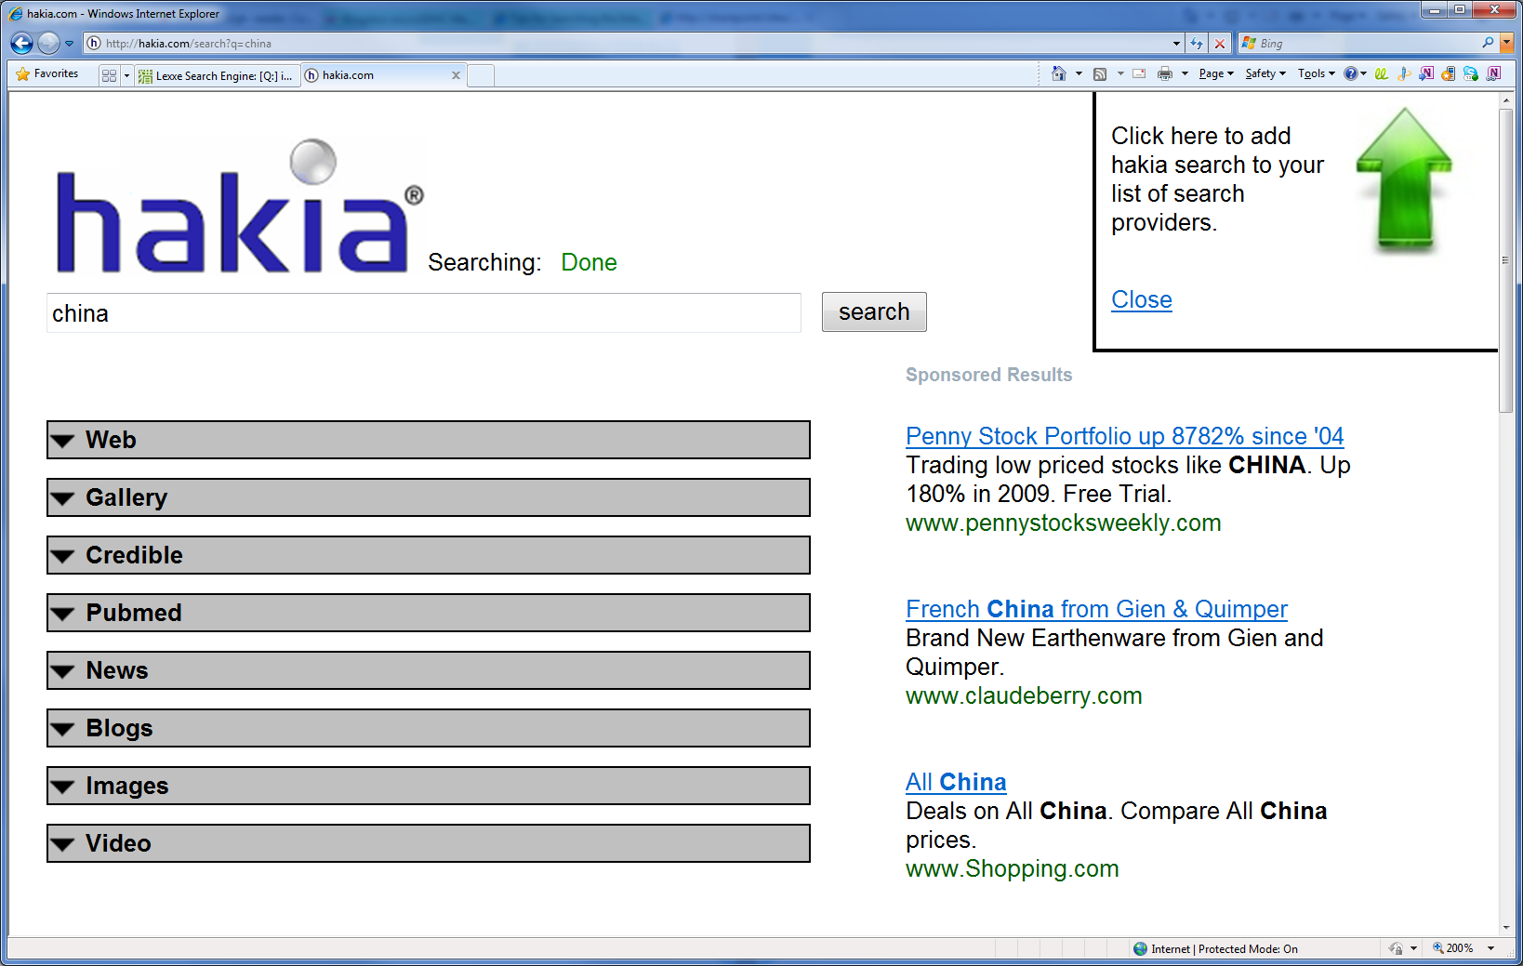
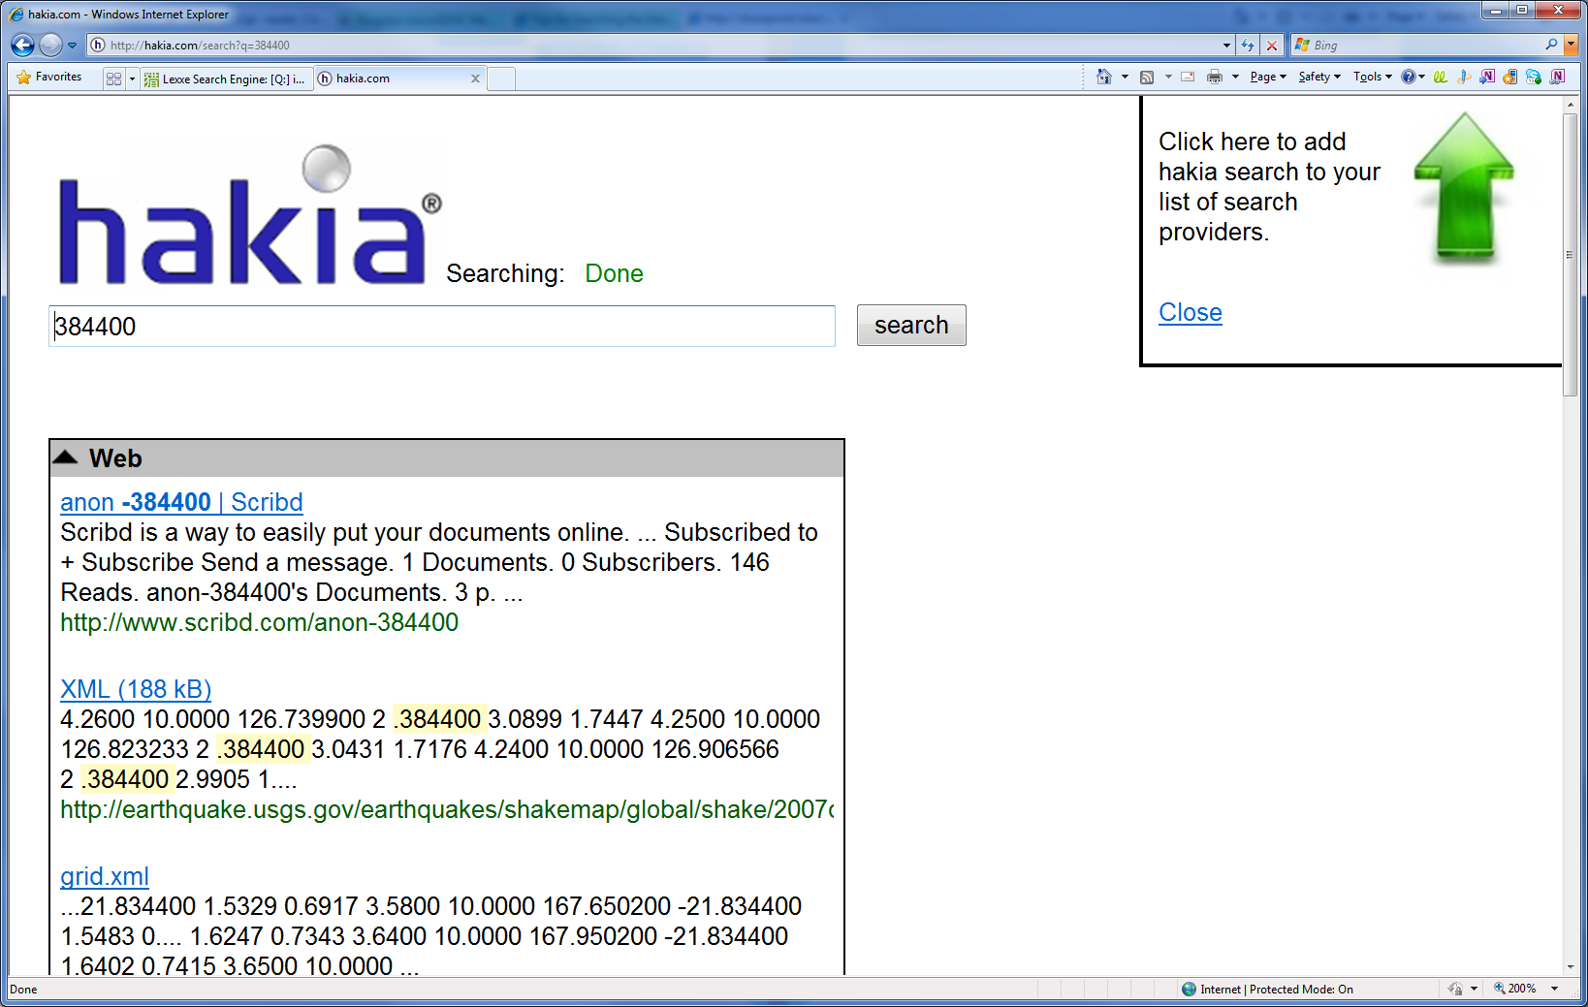
Notes:
Hakia search results are organized in tabs: Web results, credible sites, images and news. Credible sites refer to results from sites that have been vetted by librarians and other information professionals invites by Hakia to identify credible web sites.

Slide 23
Hakia’s Data Coverage
Open Web, Twitter, Wikipedia, Images
Credible Sources: query.nytimes.com, www.wcs.org, www.grist.org, movies.nytimes.com, etc
PubMed: http://www.ncbi.nlm.nih.gov/pubmed/
News: english.people.com.cn, blogs.fco.gov.uk, etc
Blogs: www.bloggernews.net, thenextweb.com, etc
Videos: get mostly from YouTube
Galleries: http://gallery.hakia.com/(get mostly from Credible Sources)

Slide 25
Facts
Who:
Dmitri Soubbotin (Founder and CEO)
Where:
New York City
Main products
SenseBot, LinkSensor, Semantic Cloud API

Slide 26
Features
SenseBot:
Summarize search results into one concise digest
LinkSensor:
semantically analyzes a document on-the-fly and highlights key concepts in the text.
Semantic Cloud API:
extracting semantic concepts from a document, generating multi-document summary

Slide 27
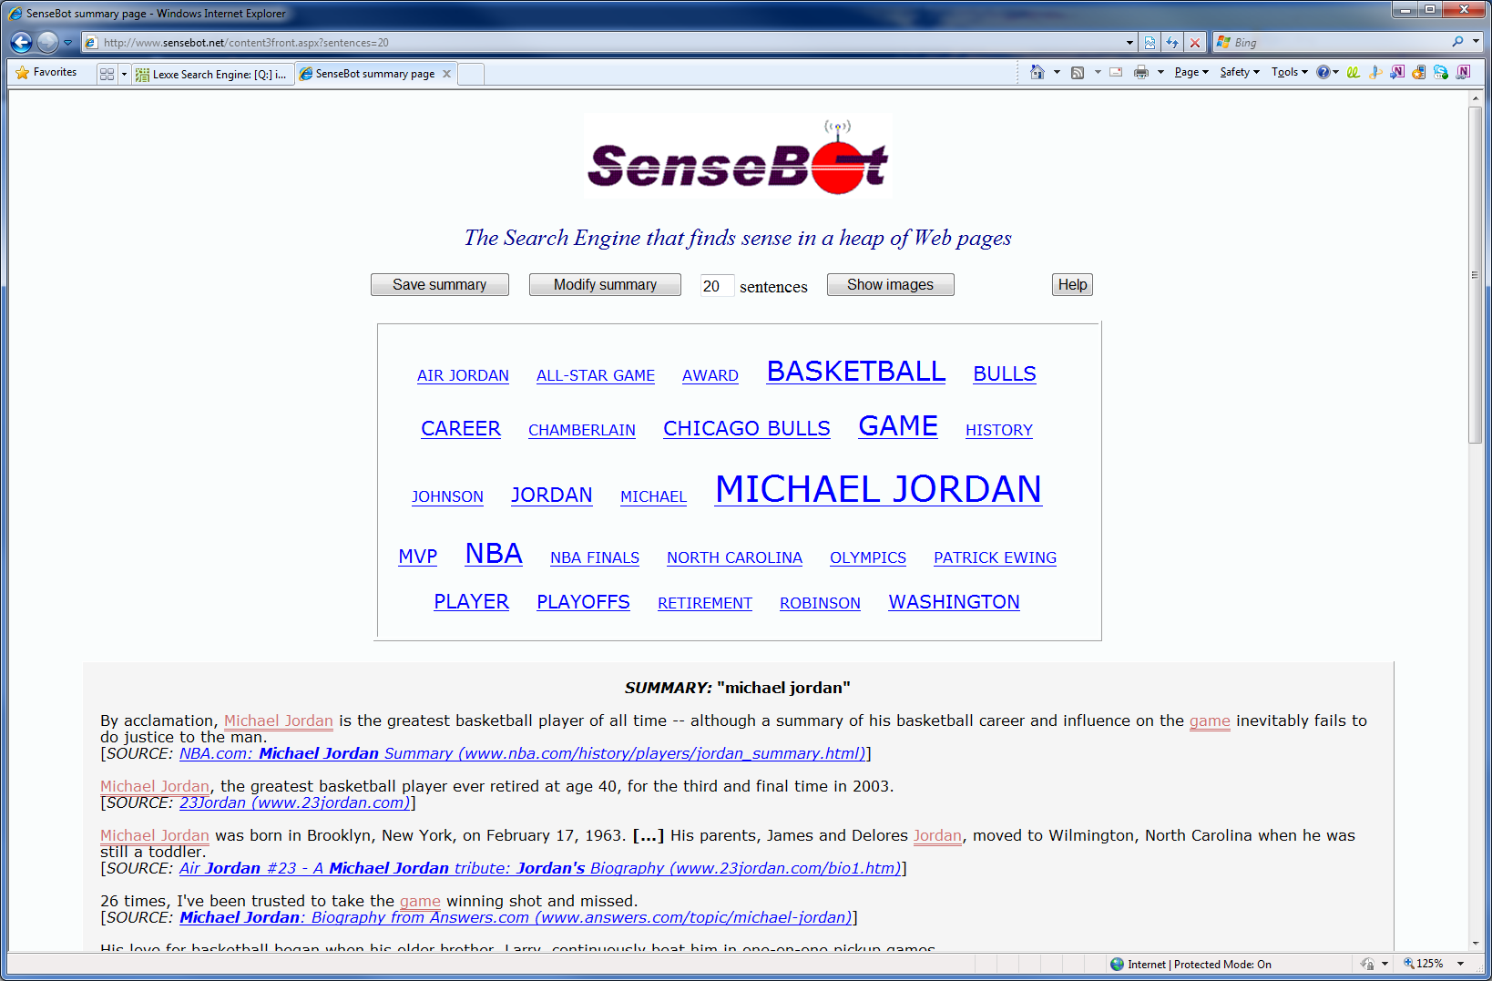

Slide 28
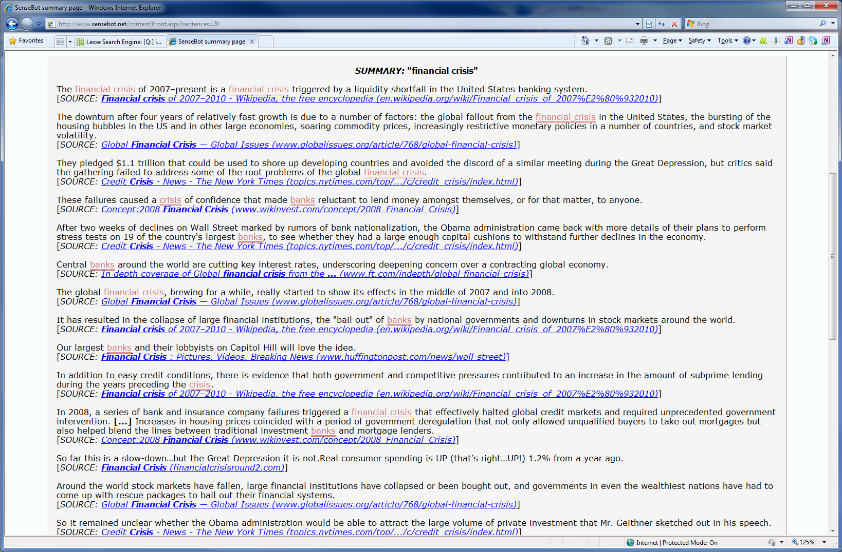

Slide 30
Facts
Who:
Qianjin Hu (PhD Biology, SUNY)
Where:
Headquartered in Sunnyvale, CA, with offices in Shanghai, China
When:
Founded in 2005 and changed name to DeepDyve on Nov 11, 2008

Slide 31
Features
Largest online rental service for scientific, technical, and medical research
Deep web search
Search for key phrases (instead of key words) in scientific articles
Rent an article for 24 hours for 0.99c
Suggestion of related articles

Slide 32
Technology
Data source: Research articles from authoritative journals
KeyPhrase
indexes phrases up to 20 keywords in length rather than just single keywords
matches patterns and symbols

Slide 33
Strength and Weakness
Strengths
Get access to some deep web data
Support long queries like paragraphs
Actually not that good
Can’t find the article a paragraph belongs to sometimes
Suggestion of related information
“more like this”
User preference
Weaknesses
Not free (“as little as $0.99 per article”)
Limited data source
Not smart enough
Why not Google Scholar?

Slide 35
Facts
Who:
Kathleen Dahlgren (founder, UCLA linguistics Professor)
Scott Jarus (CEO)
Where:
Culver City, CA
When:
Feb 2003

Slide 36
Features
A linguistic search engine that supports ontology, morphology, and synonymy
Vertical market strategy
4 domains currently: Legal, Health, Wiki, Bible
Performance may be a bottleneck in an open Web context

Slide 37
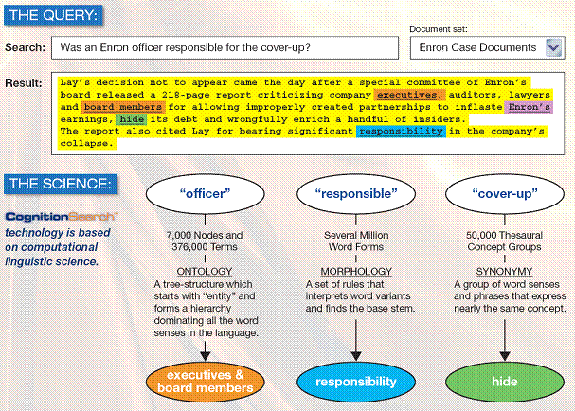

Slide 38
Technology
A Semantic Map (like WordNet) which has been (manually) building for 24 years
506, 000 word stems; 536, 000 word senses
A taxonomy with 7, 500 nodes and 536, 000 leaves
A meaning thesaurus with 75, 000 groupings
4, 300, 000 sense contexts (for disambiguation)
Other syntactic and semantic information
A Powerful Semantic NLP Parser based on the semantic map

Slide 39
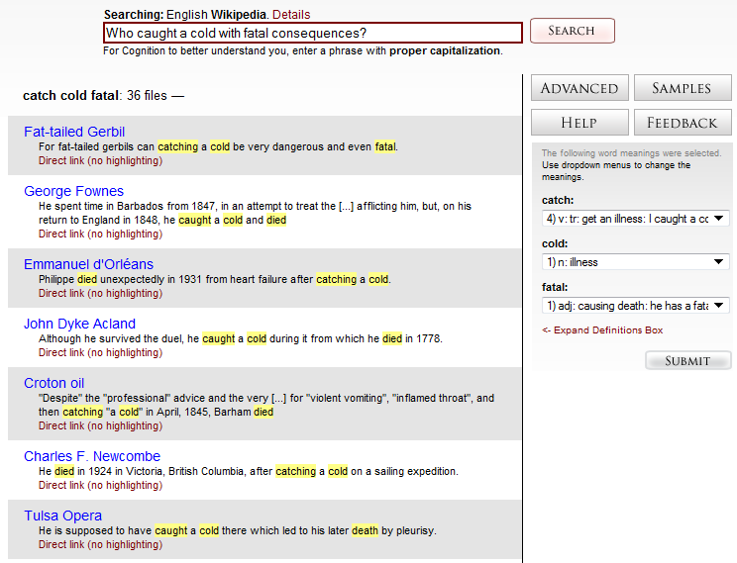
Cognition
Sense of keywords in the query
Notes:
A sample query on the Wikipedia domain.

Slide 40
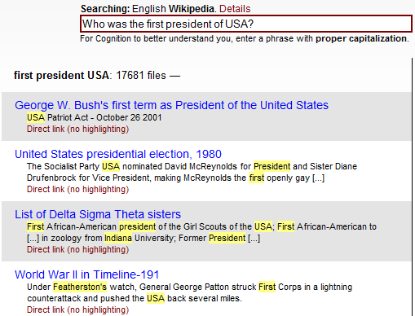
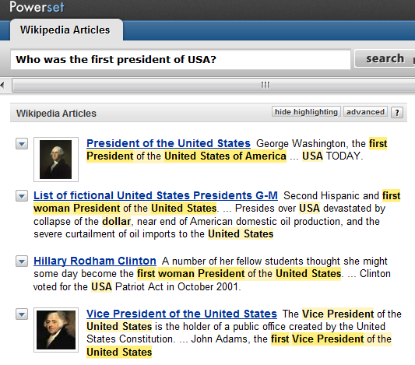
Who was the first president of USA?
From Cognition
From Powerset
Notes:
Not so effective results from Cognition with the query “Who was the first president of USA”, compared with Powerset.

Slide 41
Weakness
The greatest problem linguistic or semantic search engines: scalability.
Dahlgren, "We were able to index the whole 16 million records in MEDLINE in one day."
Jarus, "The only challenge is when we have performance problems; then we need to add more machines, more hardware. It's a commoditized problem."

Slide 42


Slide 43
Facts
Who:
Venky Harinarayan, Anand Rajaraman (Standford, Junglee, Amazon)
Where:
Mountain View, California
When:
2005

Slide 44
Features
Kosmix: the web organized for you
It’s more like a Yahoo portal : a dashboard of relevant videos, photos, news, commentary, opinion, communities and links to related topics.
It presents related topics allowing users to explore the Web by topic.

Slide 45
Technology
For a keyword or topic that a user enters, Kosmix gathers content from across the Web to build a sort of multimedia encyclopedia entry on the fly
A taxonomy including nearly 5 million topics, and millions of connections among those topics.

Slide 46
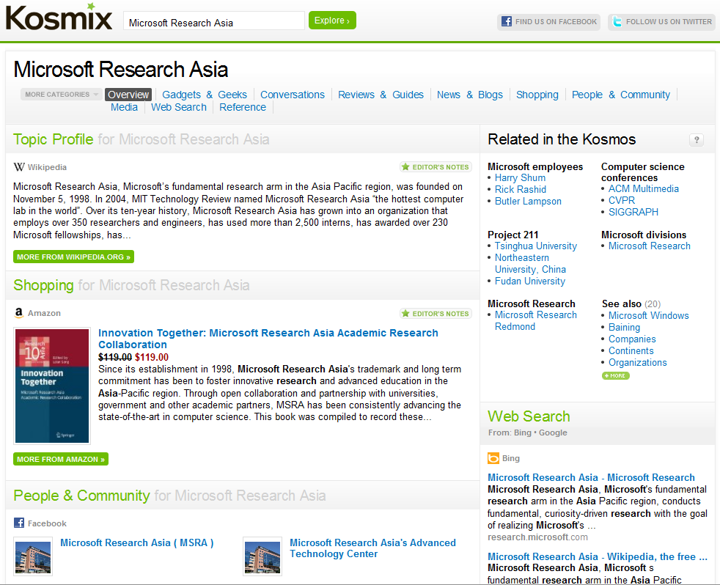
Notes:
On the top are the different categories of results associating with the given topic.
On the right is related topics with the given topic.

Slide 47
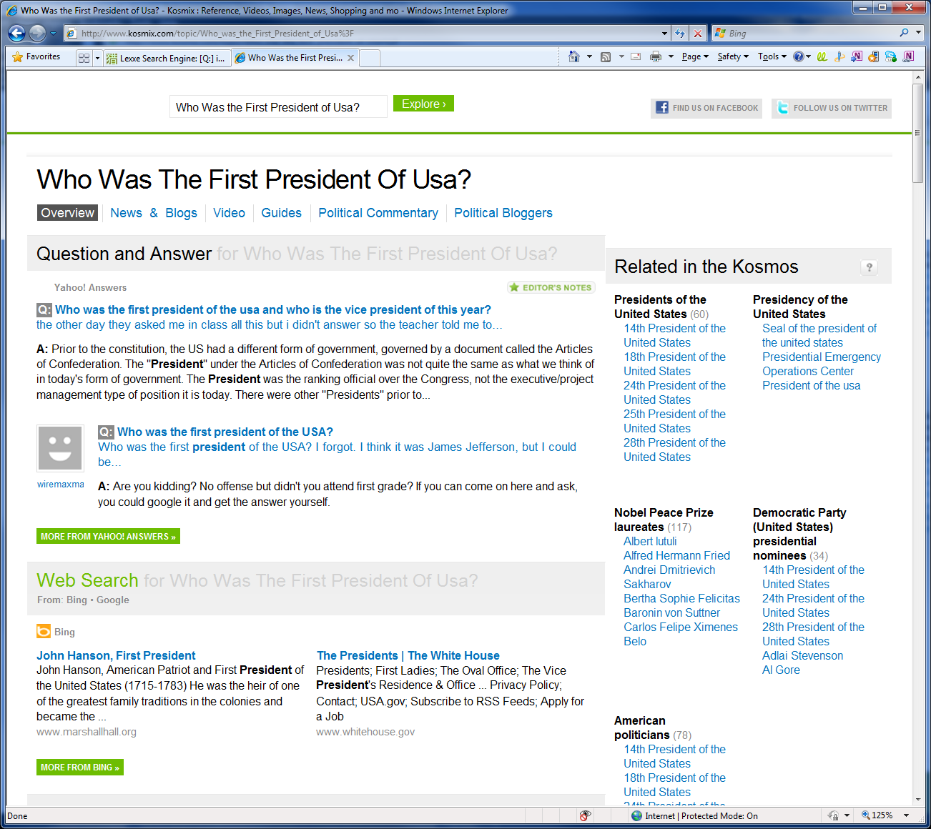

Slide 49
Facts
Who:
Francois Bourdoncle (previously with AltaVista)
Where:
Paris, France
When:
Oct. 9 2006

Slide 50
Features
Databases: A database of crawled Web pages and an image database. Ad database comes from Yahoo! Search Marketing.
Strengths: * Truncation, proximity, and many other advanced operators * Includes thumbnails of pages * Provides excellent narrowing options on right side
Weaknesses: * Smaller database than the major search engines * May not be updated as frequently

Slide 51
Advanced Operators
What are you looking for?
Exact Phrases e.g. "to be or not to be"
Exact Words e.g. +the godfather
Optional Terms e.g. cow OPT mad
Exclude Terms e.g. star -movie
Prefix Search e.g. Jenn*
Proximity Search e.g. movie NEXT star
Logic e.g. (movie AND star) OR (famous AND people)
Phonetic Search e.g. soundslike:shakespear
Approximate spelling Search e.g. spellslike:exlaead
Where do you want to find it?
Site Search e.g. movie star site:flickr.com
Title Search e.g. intitle:"official website"
URL Search e.g. inurl:music
Link Search e.g. link:www.exalead.com
In which period of time are you interested?
Search Before a Date e.g. movie star before:2004/05/21
Search After a Date e.g. movie star after:2004/05/21

Slide 52
Image Search
Example: albert einstein imagecontent:Face realism:Photo color:orange
search images based on size (Small, Medium, Large), content (Face), pixel size (800×600, 1024×768, 1280×768) and image color (color, Gray scale, Black & White).
Techniques: LTU Engine for image search: http://www.ltutech.com/en/products/ltu-engine-2
for reviews on image search, see http://www.webadvantage.net/webadblog/face-to-face-with-image-search-473

Slide 53
Enterprise Search
Goal: solve the problem of search for content where link analysis is of little help

Slide 55
Facts
Who:
Hong Liang Qiao (Ph.D in computational linguistics)
Where:
Sydney, Australia
When:
Oct 2004

Slide 56
Features
Lexxe allows users to ask short questions
6W’s and 1H (who, what, which, when, why, where and how).
It is also able to answer affirmative questions, which require either “yes” or “no” as answer.

Slide 57
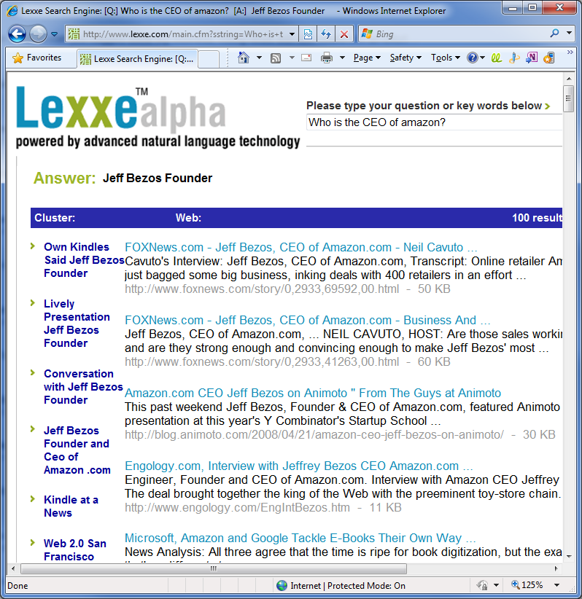

Slide 58
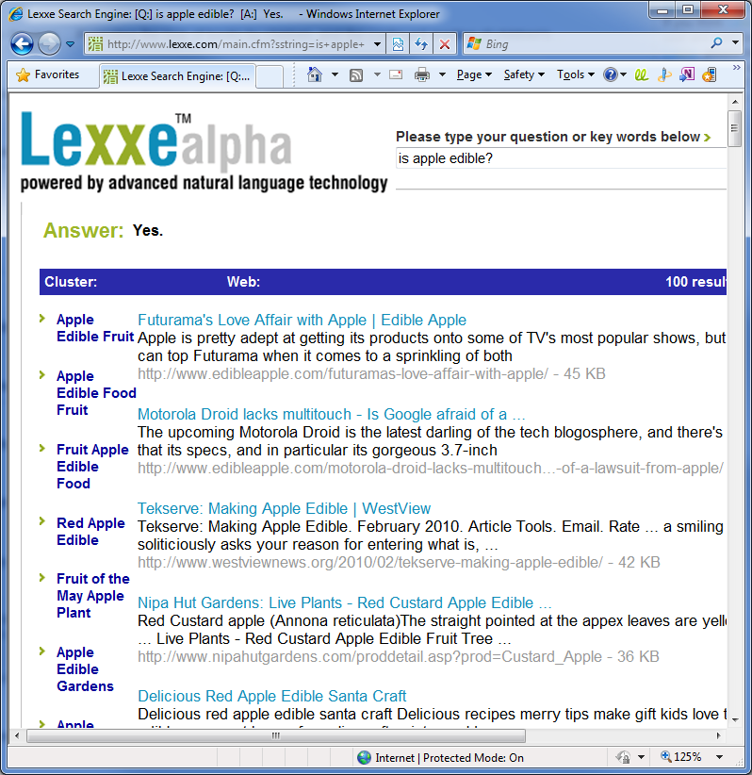
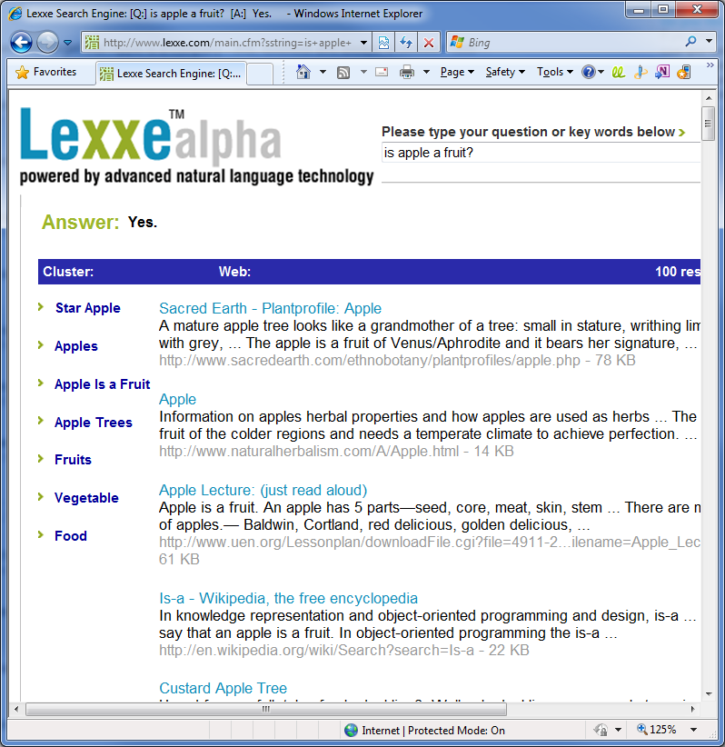
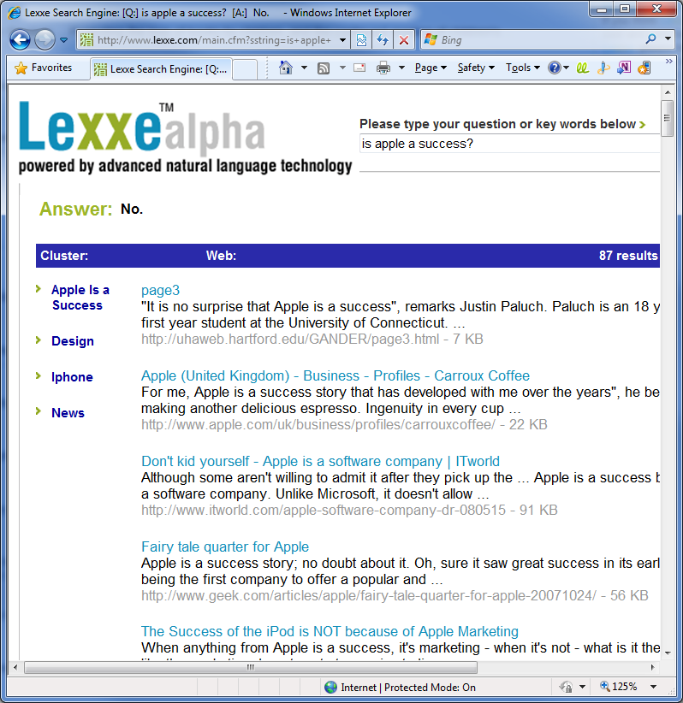
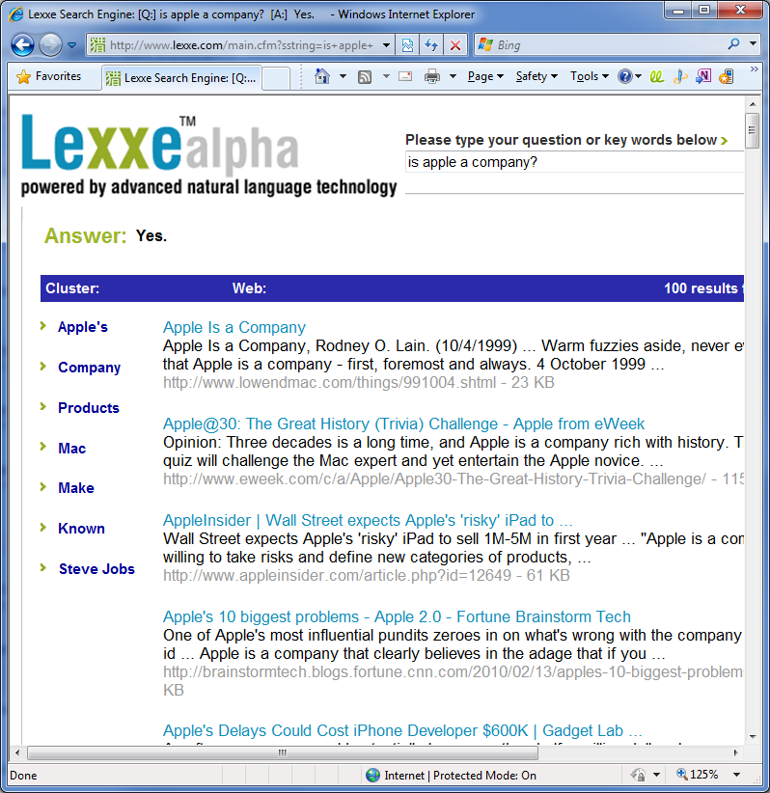

Slide 59
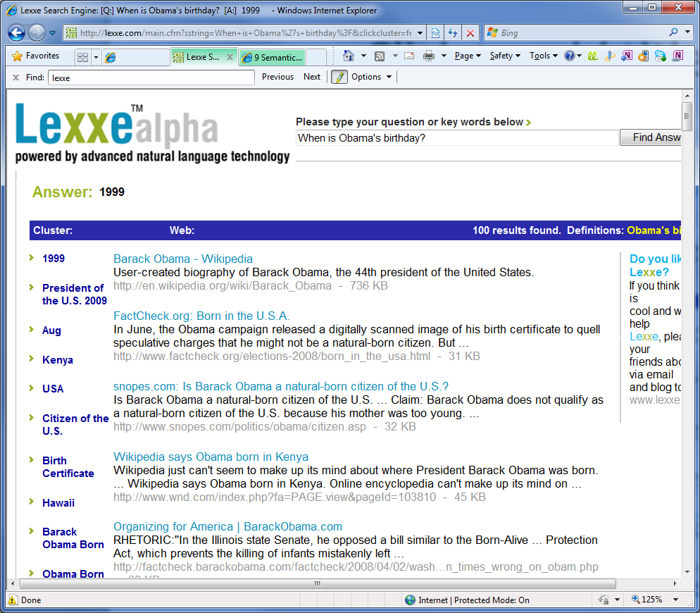

Slide 60
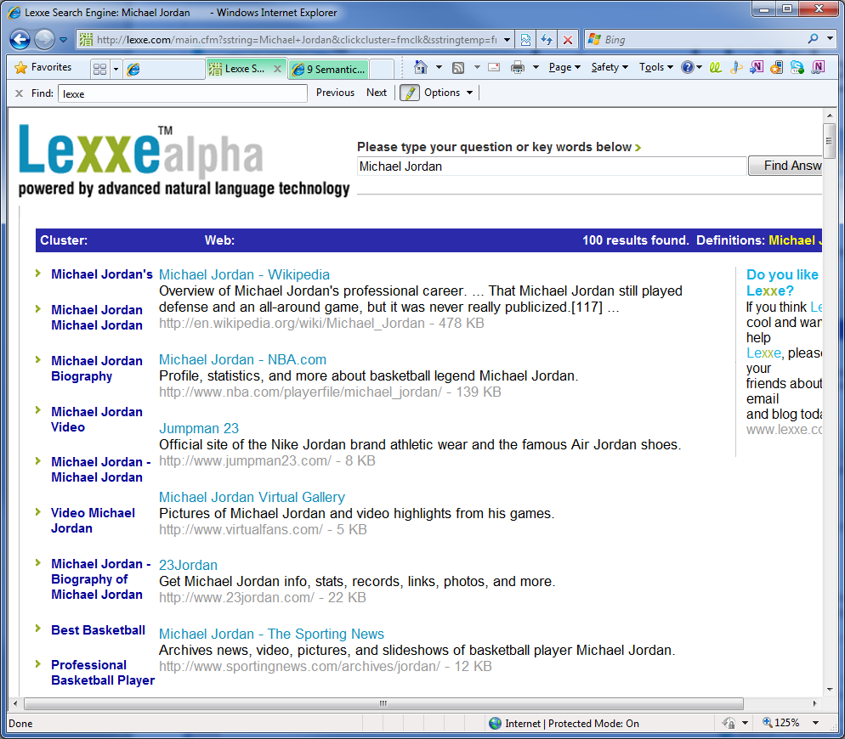
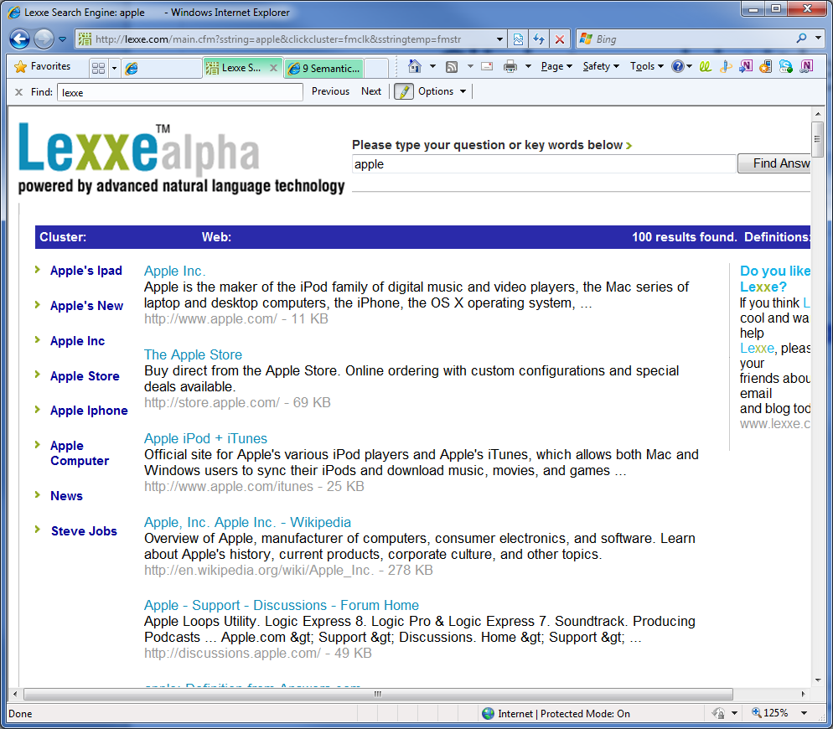

Slide 62
Facts
Who:
Li Ding (PhD, UMBC) and Ebiquity Research Group
Where:
Baltimore, MD
When:
February 2004
Meaning:
Semantic Web + google = Swoogle
Paper:
Swoogle: A Semantic Web Search and Metadata Engine
Notes:
The Resource Description Framework (RDF) is a general-purpose language for representing information in the Web.
RDF/XML is a syntax, defined by the W3C, to express (i.e. serialize) an RDF graph as an XML document.
Turtle (Terse RDF Triple Language) is a serialisation format for RDF graphs.
N-Triples is a format for storing and transmitting data. It is a line-based, plain text serialisation format for RDF graphs, and a subset of the Turtle (Terse RDF Triple Language) format
The data are from Swoogle Manual: http://swoogle.umbc.edu/index.php?option=com_swoogle_manual&manual=glossary#SemanticWebDocument

Slide 63
Sample Queries
Keyword search
Single Term, e.g., "computer”
Phrase, e.g. “personal computer “.
Wildcard Searches. "?" for single char and “*” for multiple characters.
Boolean Operators. Supported operators include AND, OR, and NOT.
Advanced Search using field constraints
“def:computer”
Definition contains computer
“desc:computer”
Description contains “computer”
“def:computer hasDateLastmodified:[2007-01-01 TO 2007-07-10]”
Description contains computer, and is modified during 2007-01-01 to 2007-07-10.
Results
Ontology/document
Term

Slide 64
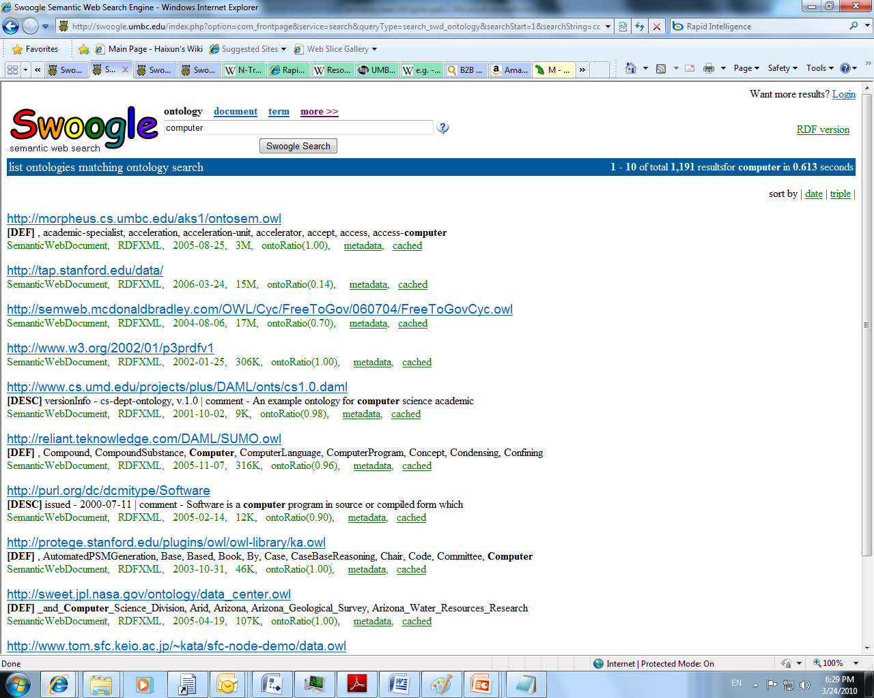
Notes:
Search Ontology with query “computer”

Slide 65
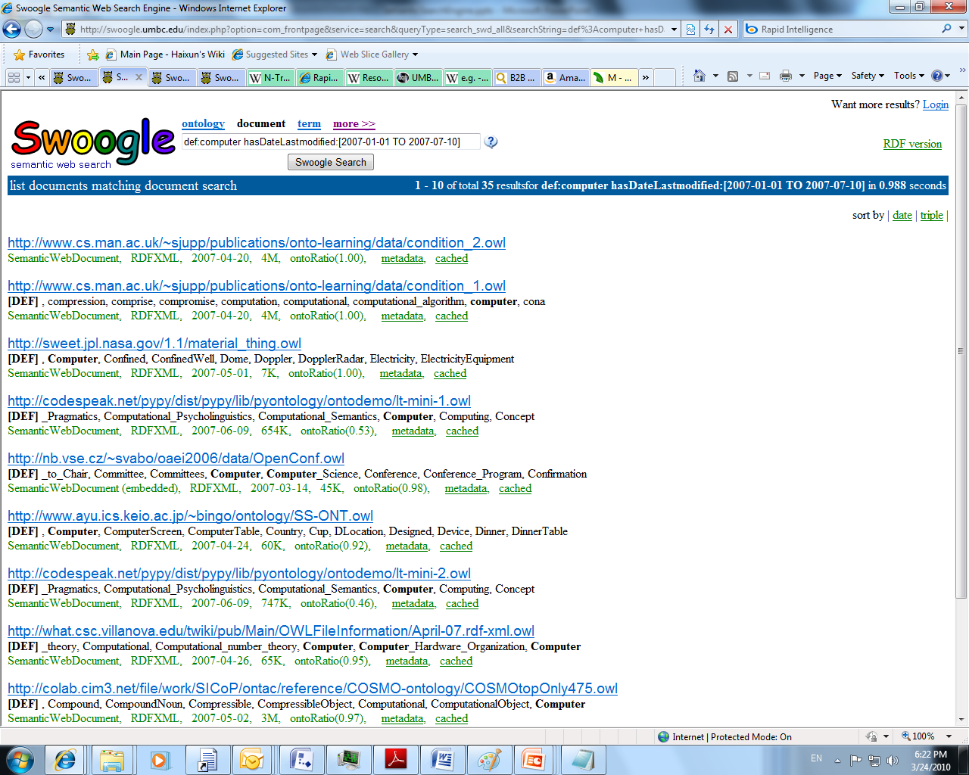
Notes:
Search document with query “def:computer hasDateLastmodified:[2007-01-01 TO 2007-07-10]”

Slide 66
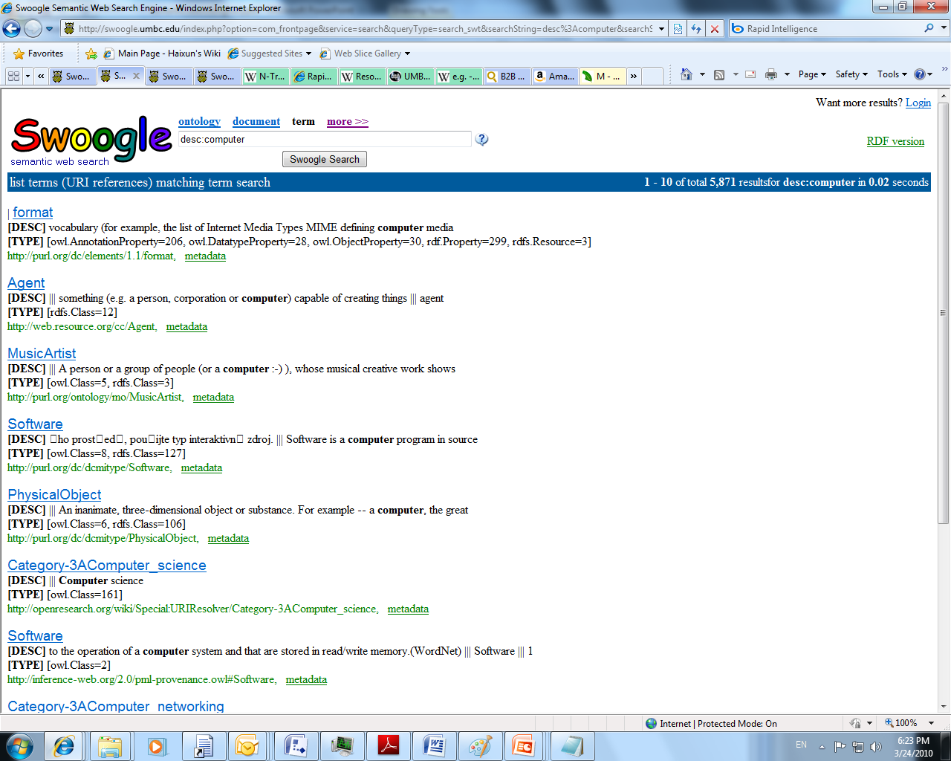
Notes:
Search terms with query “desc:computer”

Slide 67
Technology
Use normal search engine technology to crawl and index the semantic documents.
Google-type page ranking
Mining the documents for inter-relationships that are the basis for the semantic web.
Rank results on the importance of a Semantic Web document.
Documents on the semantic web.
notations such as RDF Schema (RDFS), the Web Ontology Language (OWL)
document represented as an Resource Description Framework (RDF) graph:
a variety of data interchange formats (e.g. RDF/XML, Turtle, N-Triples)
Current scale
10,000 ontologies
1.3 million RDF documents
1 billion triples parsed from RDF documents

Slide 68
Strength and Weakness
Strengths
focus on semantic web document
Index tags in ontology documents
Weaknesses
Limited number of documents

Slide 70
Facts
Who:
Luke Metcalfe and Rapid Intelligence
Where:
Sydney, Australia
When:
April, 2005
Meaning:
A fact bite is a very short piece of information. So factbites means a collection of pieces of information.
Notes:
The Resource Description Framework (RDF) is a general-purpose language for representing information in the Web.
RDF/XML is a syntax, defined by the W3C, to express (i.e. serialize) an RDF graph as an XML document.
Turtle (Terse RDF Triple Language) is a serialisation format for RDF graphs.
N-Triples is a format for storing and transmitting data. It is a line-based, plain text serialisation format for RDF graphs, and a subset of the Turtle (Terse RDF Triple Language) format
The data are from Swoogle Manual: http://swoogle.umbc.edu/index.php?option=com_swoogle_manual&manual=glossary#SemanticWebDocument

Slide 71
Features
The results are organized by sentences.
Related words shown in the results are highlighted and linked to corresponding topics in factbites.
Show diverse search results.

Slide 72
Sample Queries
Good queries
Company
(will show the pages for different meaning of “company”, for example, the pages where “company” as a business unit, military unit, the name of a book, the name of a musical comedy or the name of a movie).
Corporation
(will mark the related words in the snippets , such as “board of directors” , “stock” and “shareholders”, and link them to corresponding topics in Factbites).
Bad queries
MS
(will show the result for “M”, caused by limited number of supported topics)
gate
(return only 3 pages, caused by limited indexed documents)

Slide 73
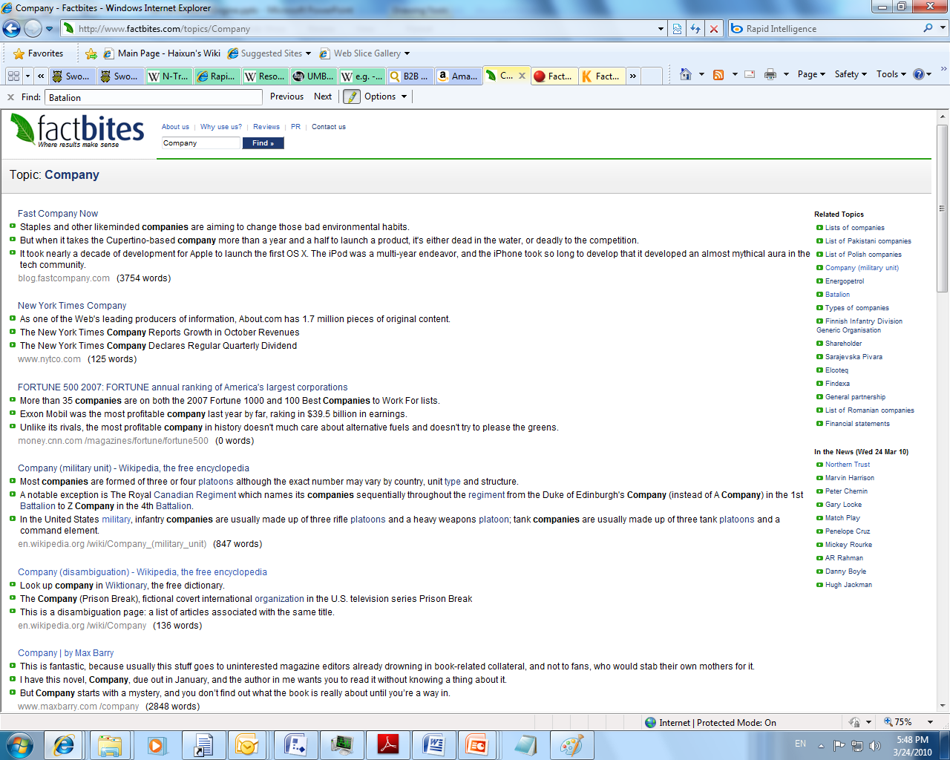

Slide 74
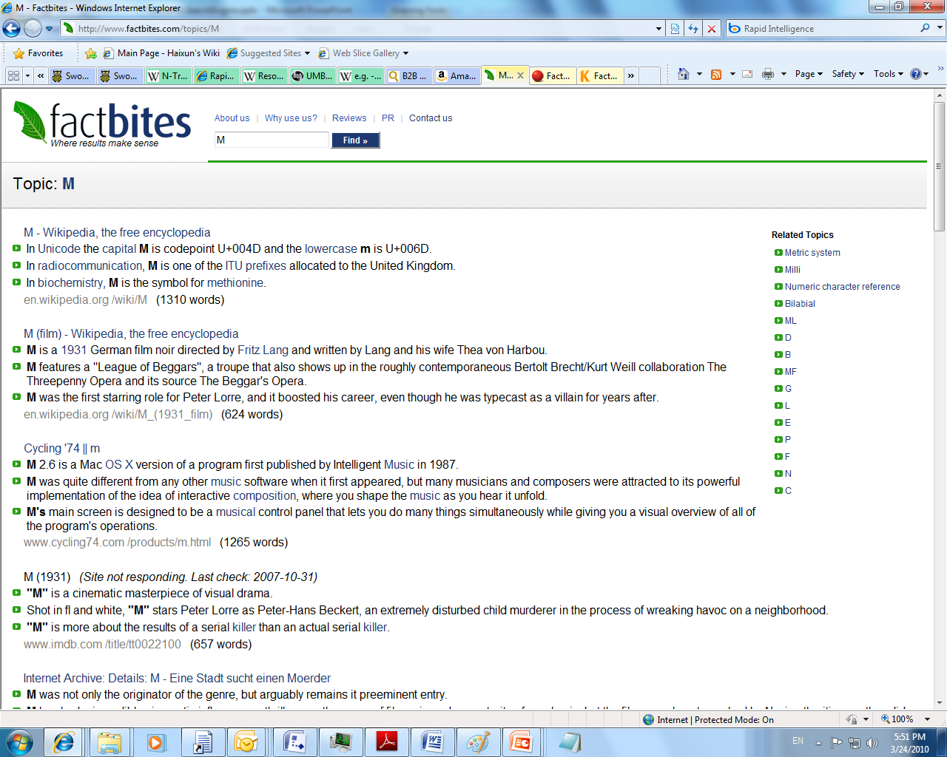

Slide 75
Technology
Break documents to sentences.
An ontology on topics. It contains a synonym set and related word set for each topic.
Results ranking is optimized for diverse topic coverage.
Document coverage
Web document
Current scale: 800,000 topics

Slide 76
Strength and Weakness
Strengths
Return complete sentences as the snippets of results to the users.
Select meaningful results.
Mark the related words in the snippets of the results.
Weaknesses
Limited number of supported topics or keywords (only 800k).
Complicated queries are not well supported. For example, the queries contains multiple topics.

Slide 78
Facts
Who:
Stephen Wolfram, who created Mathematica and Wolfram Research
Where:
Champaign, IL, with other locations in UK, Japan, MA and France
When:
May 2009
Named after the founder

Slide 79
Main Features
Natural language queries
Complex mathematical computations
Focused on scientific facts and numbers
Present answer in tables, graphs and various other forms
Provided an API

Slide 80
Sample Queries
Math expressions: lim(x->0) x/sin x
General Computations: mortgage 6%, 25 year, $140000
Scientific knowledge: boiling point of water at 6 atm
Attribute values of well known entity: per capita income of Zambia
Natural language fact-based questions: how old is Obama?
But it can’t do: how old was Obama when he was elected president?

Slide 81
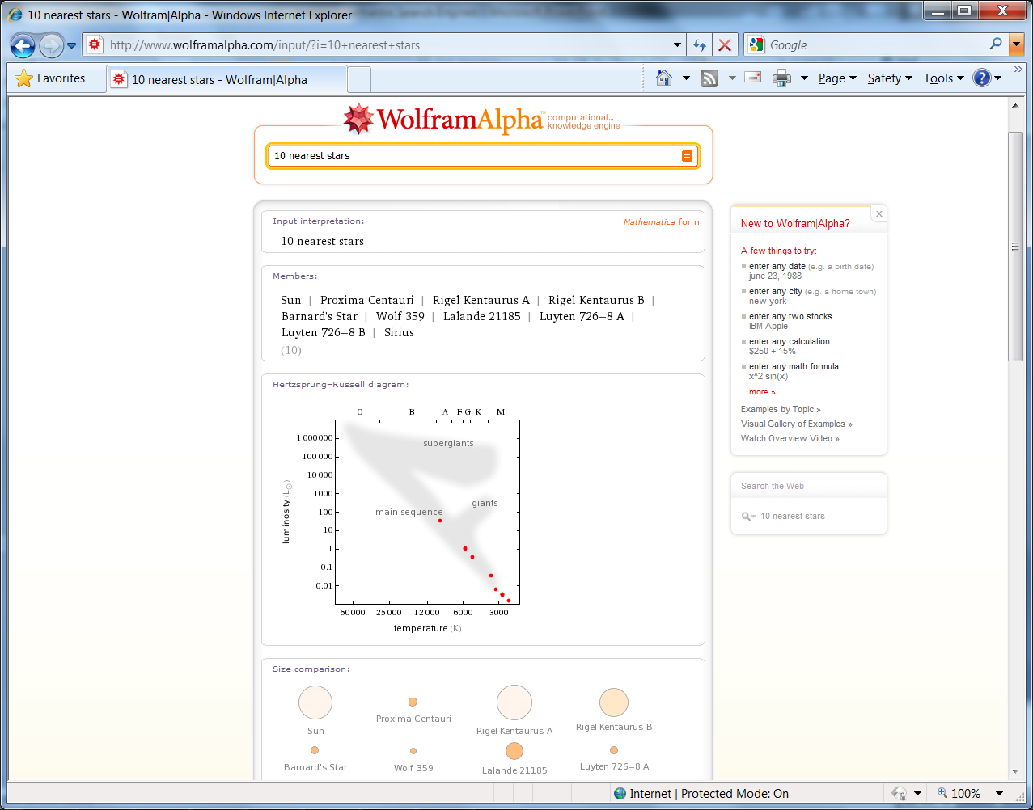

Slide 82
Technology
NLP techniques to parse and retrieve tokens
Mathematica contains important scientific facts and formulas
Mathematica and 10,000+ CPUs do the computation
Data sources:
Mathematica Proprietary Human Curated Data
No web data or commercial product data for now

Slide 83
Strength and Weakness
Strength
scientific queries
complex computation
mathetical inference
Weakness
not a general purpose search engine
domain specific (e.g. no product data)

Slide 85
Facts
Who:
Paul Allen (main investor)
Where:
Seattle, WA
When:
June 2008
Recently acquired Radar Networks
Pronounced as “ev-ree”

Slide 86
Features
A semantic web recommendation service for publishers
Web interface present news related results
Provides web service APIs/widgets for other businesses (e.g. Washington Post, Times) and Bloggers
Analyze text
Give recommendations
Discover relationships (connections) between entities (from news)
Mine facts (like Wikipedia’s info table and Amazon’s product data)
Popularity data

Slide 87
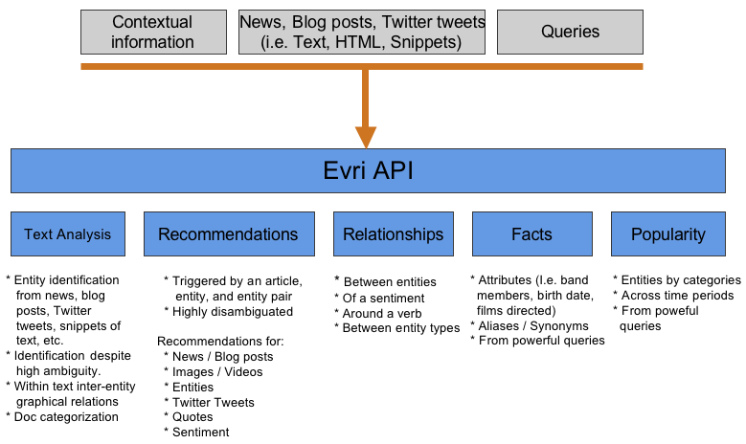
Evri APIs

Slide 88
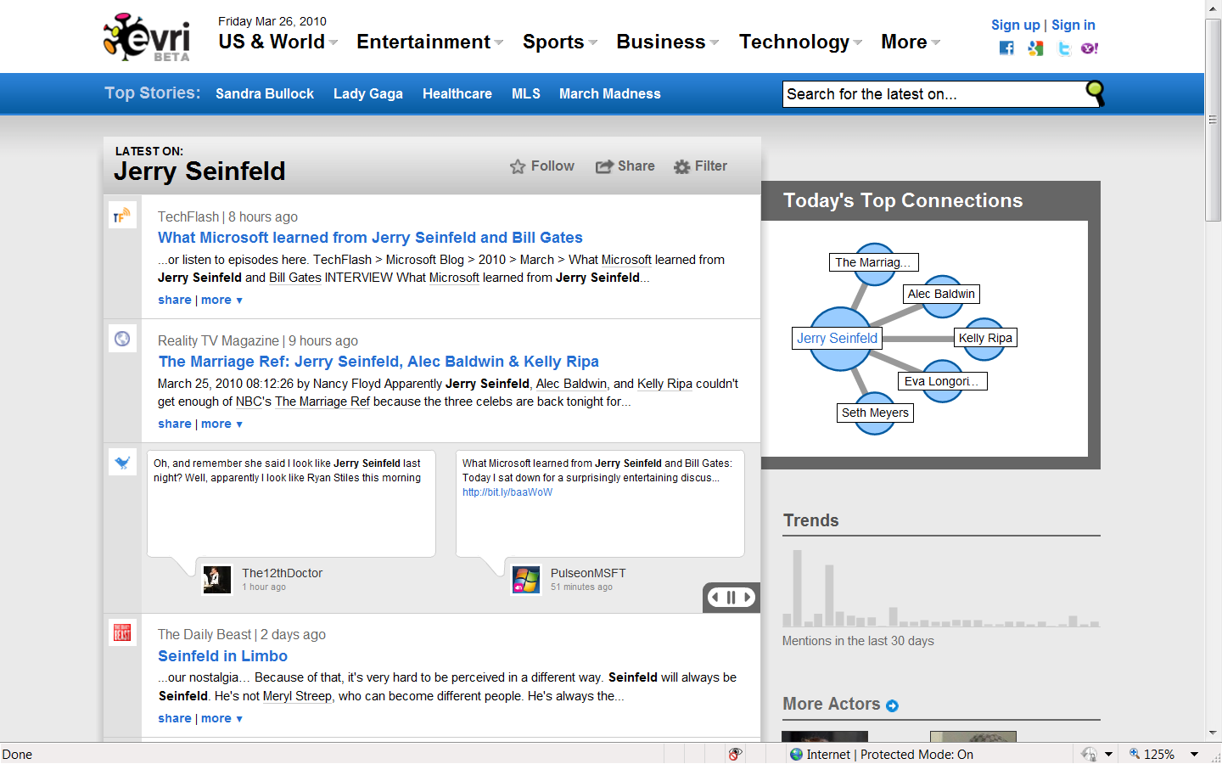

Slide 89
Technology
NLP techniques
Discover entitles in free text
Construct graph of relationships among entities
Infer context from these graphs
Infer sentiment from text
Categorize text based on some ontology
Data sources: Wikipedia, Amazon, Crunchbase, Freebase, etc.
Mainly targets news, sports, products knowledge

Slide 90
Strength and Weakness
Strength
free text analysis
accurate recommendation
entity relationships
popularity of entity
Weakness
targets only news, sports, products for now
Not working well for less known entities

Slide 92
Facts
Who:
Gabriel Weinberg (BS, SM, MIT)
Where:
Valley Forge, Pennsylvania
When:
Sept 25, 2008
Name derived from the game “Duck Duck Goose”

Slide 93
Features
Zero-click info
Disambiguation page
Topic list
Categories
Does calculations and conversions like google
Result page is script based and has keyboard shortcuts
Result page can grow without clicks

Slide 94
Sample Queries
Concept/entity exact match: “zero click info” as well as keyword search results, e.g. “Duck Duck Goose”
Concept/entity with more than one match: a disambiguate page for people to pick the intended topic
query contains a known concept/entity: suggest it as a likely topic
No match: normal keyword search
No automatic query expansions but corrects misspellings automatically
“birthday of barack obama” → gives wrong zero click info
“Time in beijing” → 11:22:57 pm CT | Wednesday, March 24, 2010 More at WolframAlpha

Slide 95
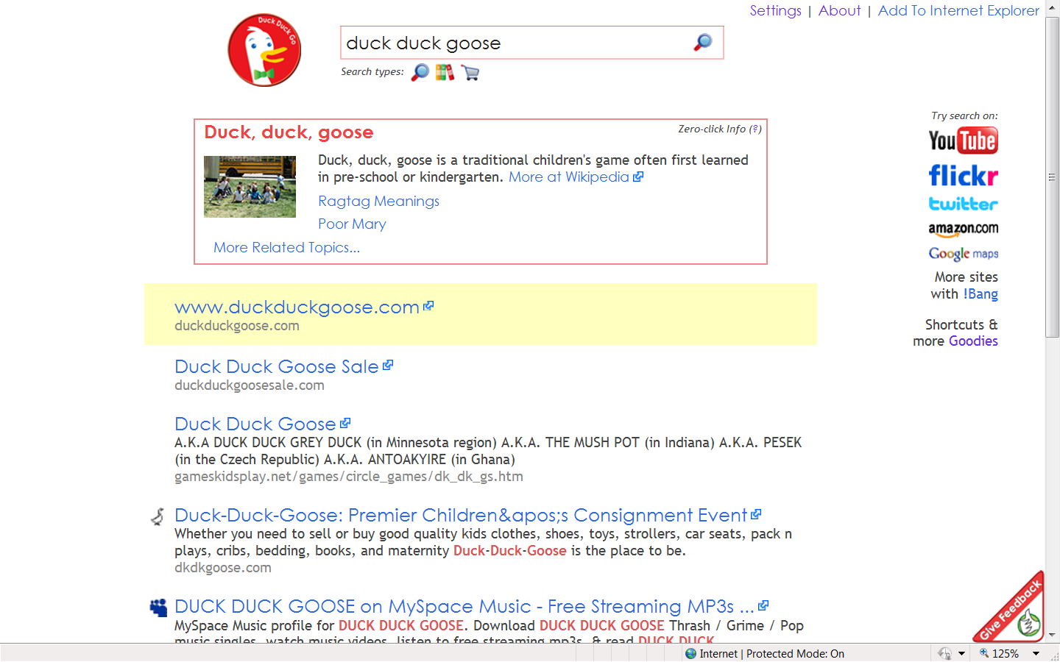

Slide 96
Technology
Data sources
(Subset) of Wikipedia Ontology
Yahoo Search! BOSS
Real Time results from WolframAlpha
Spell check/correction
No attribute/value info

Slide 97
Strength and Weakness
Strength
disambiguate concepts/entities
topic lists
default to normal keyword search if concept/entity match fails
does spell check and correction
Weakness
small knowledge base
can't handle complex queries
no attribute/value search

Slide 98
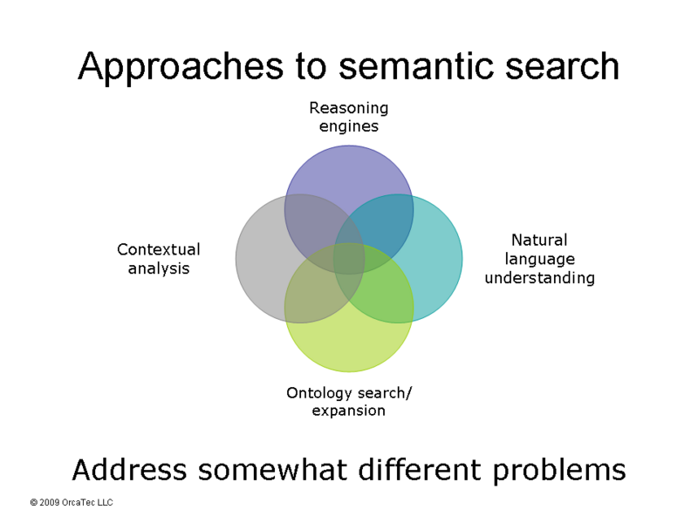

Slide 99
Conclusion
Traditional search engine: flat info
Semantic search engine: contextual and structured info, a.k.a knowledge – to complement, not replace
Key to success: scale, scale, scale!
Scale up the data sources: whole web + others
Scale up the complexity of NLP in sources and queries
Scale up the knowledge storage and real time performance

